Slide 1

Zack Knight-Looking for love

Slide 2
Storyline
The storyline would consist of an unfaithful woman who is cheating on her partner. The partner will be the lead singer who will be lip syncing with the audio. Their will also be a third man who is the person that the unfaithful woman is with behind her partners back.
ACTORS/ACTRESSES
Their will be 3 characters in the majority of the music video
2 of the characters will be men and 1 of the characters will be a woman.
The lead man has to be able to lip sync and should be of Asian Ethnic Origin.
The lead woman we would also like to be of Asian Ethnic Origin but other ethnicities will be considered.
The secondary man can be of any Ethnic Origin.

Slide 3
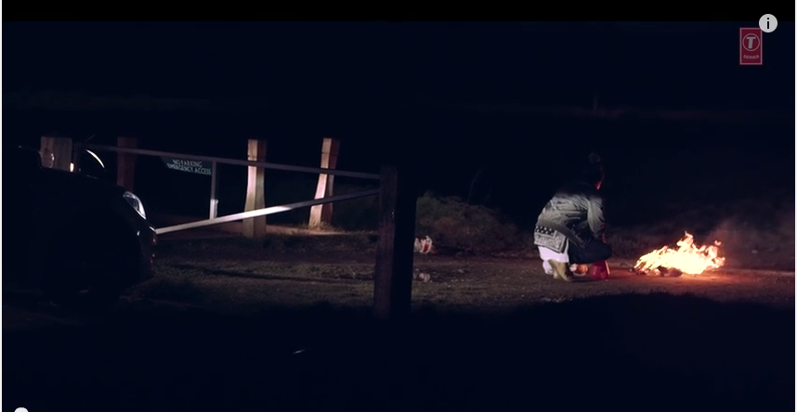
Mise-en-Scene
I would like the scenes between the lead man and woman to take place in a house in order to show the friction the two may face. We can also use the house to show the emptiness and the distance between the two. In contrast for the lead woman and the secondary man I want to use public places likes restaurants where the stereotypes of ‘romanticism’ normally take place. This could be used to represent how much in love the two are by using the stereotypes associated with this setting.

Slide 4
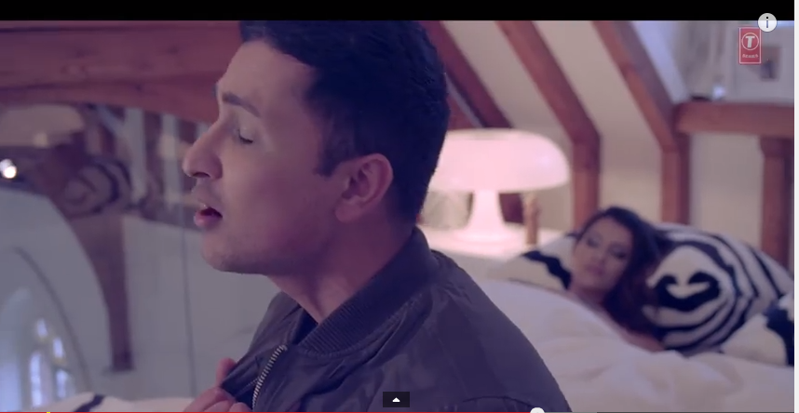
Andrew Goodwin’s theory
There is a clear relationship between lyrics and the visual as when he says “this heart you disowned” you can see him tugging his jacket which represents his heart being ripped out.
There is also a relationship between the music and the visuals as the beat drops to reflect his facial expression which is shock at the time . This shows us that there is a relationship between the music and the visuals.
There is also close ups of the artist which is accordance to Andrew Goodwin's theory that Music Videos will include close ups of artists.

