Slide 1
What have you learnt from your audience feedback?

Slide 2
In the process of editing our music video at different stages we made sure we showed our production to our target audience and also the peers in our media class. The final edit ended up very differently from our first edit proving how important student feedback is to the final production. There were three types of audience that we showed our film to. These consisted of our teacher, target audience and media students. We decided to get feedback from all 3 as this will give us a broader picture of how our music video is doing. When showing a music video to the target audience they may not understand the financial constraints so feedback may not be accurate enough for us as we do not have the budget of most financial institutions so will not be able to do exotic shots of cars and planes like some music videos in our genre. Whereas both a teacher and a media student will be able to understand the constraints that we are working with and will be able to accurately give feedback on what we need to improve upon. It was important to get audience feedback as they are the consumers of media texts and it needs to appeal to our target audience in order to be a successful music video.

Slide 3
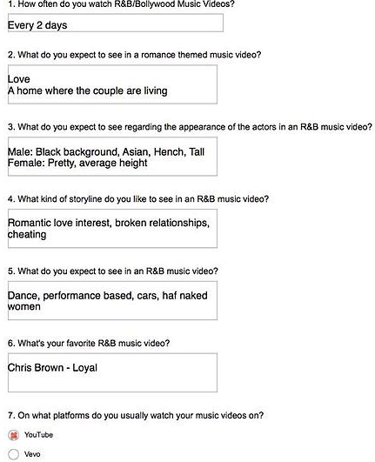
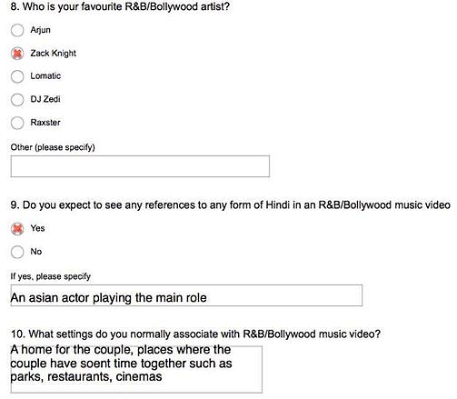
Before we started creating plans on how we will structure our narrative in the music video, we decided as a group that we needed to produce a questionnaire which asks questions about the what that audience members expect to see in a music video and the forms and conventions thet associate with our genre. The questionnaire included both open and closed questions. This type of research helped us to create our music video along with our homepage and the magazine advert. The questions were specifically about the genre that we were within which was the R&B/Hindi genre, as we wanted to know what audience members who watched music videos in this genre expected to see. This gave an idea of some forms and conventions that we needed to include in our music video. The ten people we selected were specific, as we needed people who actively watch music videos and who have an idea on the expectations of a music video. After they had completed their questionnaire we asked them to send back the questionnaire by email. The answers gave us an idea of what to include in our music video. One question we asked was “what setting do you normally associate with R&B/Bollywood music videos” and the answer to this question was that as R&B/Bollywood music videos are themed around love then there should be a home for the couple and the places that they are shown together should be locations associated with romanticism which include Restaurants and cinemas. These places are key conventions in most R&B/Bollywood music videos as the couples are often shown to be at a restaurant or a place associated with romanticism. A house was one of the answers as the audience may feel that a house is the ideal location to show love and security by a couple.

Slide 4

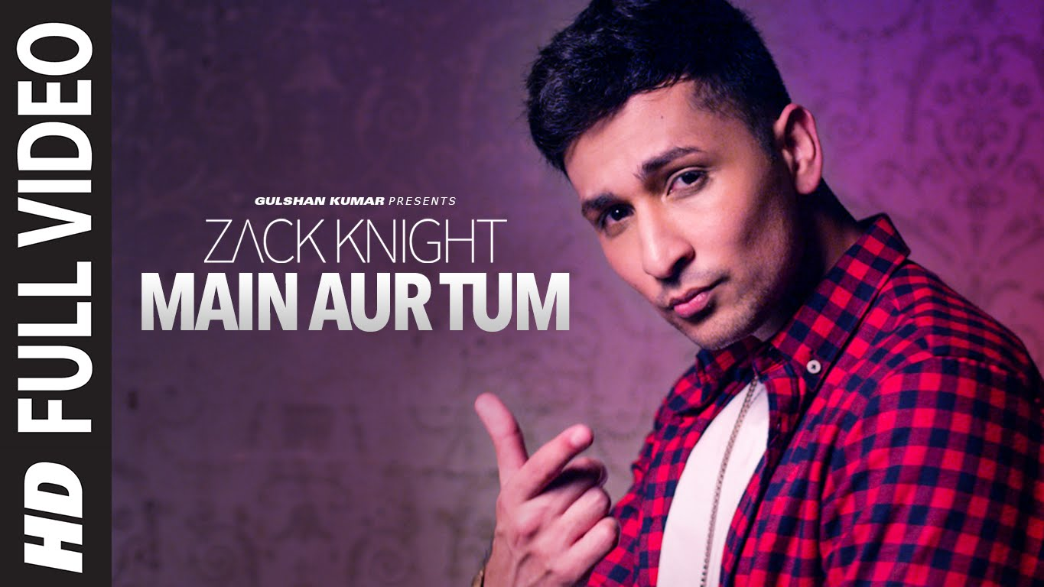
The questionnaire also asked questions about the casting that they expect to see in an R&B/Bollywood music video, they replied that they expect to see a Asian actor as the main character in the music video. This is because they expect to see some sort reference to Bollywood and by casting an Asian character it automatically references the Hindi in the music, as it is unrealistic if a white guy is shown to be playing the main character when the song has both Hindi and English parts. When we were editing our filming we asked both our target audience and media students whether the casting was ideal in that the secondary character is also Asian. They looked at the music video and said that they were confused who was the main character, which left them confused about what was happening in the story, as they couldn’t tell the main character apart from the secondary character. After receiving this feedback we then decided to re cast another actor for the secondary character in order to deal with the confusion and we looked at other ethnicities to deal with this problem. We wanted the following characteristics, tall, good body build and different ethnicity. We wanted the secondary character to be tall and have a good body build, as it is stereotype that girls who cheat often go for these defining characteristics, as the person they are with may not possess these characteristics. This would cause the audience to look at the female character negatively as this would just reinforce the stereotype that females go for someone who is tall and has a good body build.

Slide 5
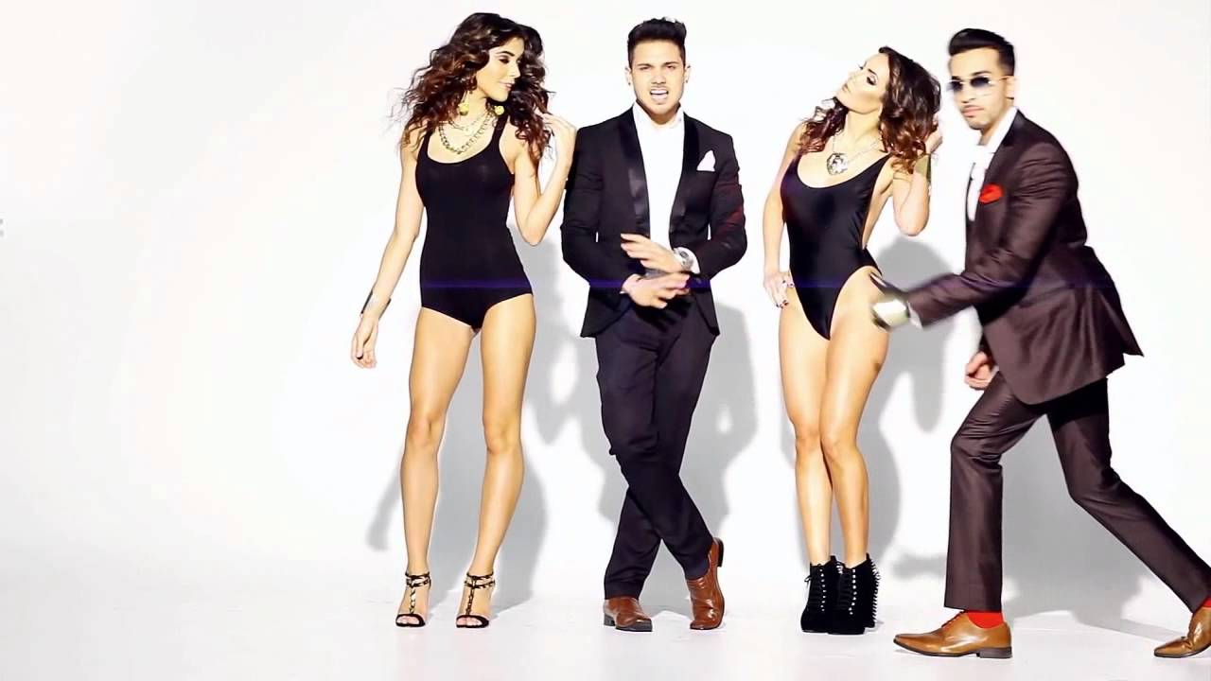
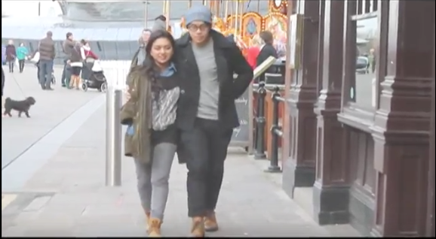
When we asked the audience what characteristics they were looking for from a female ,they said they expect her to be pretty and have average height. This is a convention that we found in many music videos in our genre and may be explained as a way of attracting the target audience, as the target audience consists of young teens they expect to see pretty women. After gathering the information that we needed we could move on to planning our music video as we had a deeper knowledge of what we needed to include. Some restrictions that we had encountered when asking the target audience in regards to the casting of female characters was that they expected to see half naked women in R&B music videos but we felt this was not needed as when we researched music videos in our genre hardly any of them included having half naked women in the music video. We felt this would then be unnecessary to include it in our music video and also inappropriate, as it wasn’t included in the criteria. We also reconsidered adding in half naked women as it may change the narrative and representation of our music video. We wanted to create a natural real life orientated music video in which it may portray real life experiences in regards to love and betrayal. Adding in half naked women is not realistic and will prevent us from creating a real life environment in order to portray real life experiences.

Slide 6
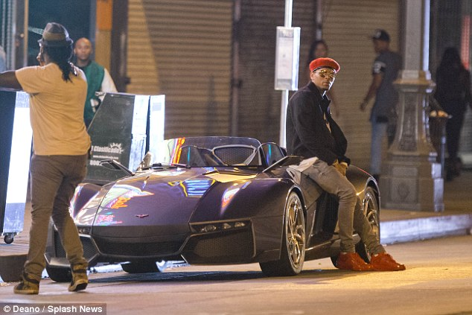
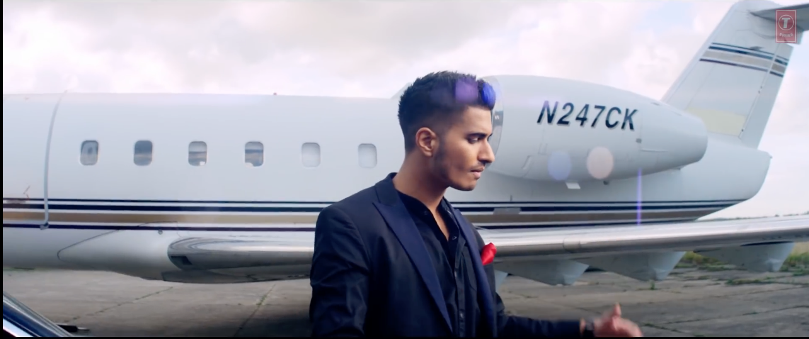
Another restriction that we encountered from audience feedback was the inclusion of fancy cars and other types of transport like planes. This was a key convention that we found in most R&B music videos. As we had nowhere near the budget of some of the media institutions, we felt we could not achieve this so we left out the expensive cars even though in our research we found that most R&B/Hindi music videos includes these vehicles. We learnt a lot of what audiences expect to see in a music video so gave us valuable information on what to include in our music video and made it easier to story board our media production.

Slide 7
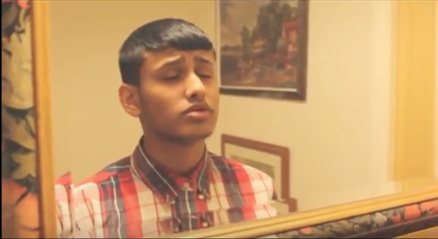
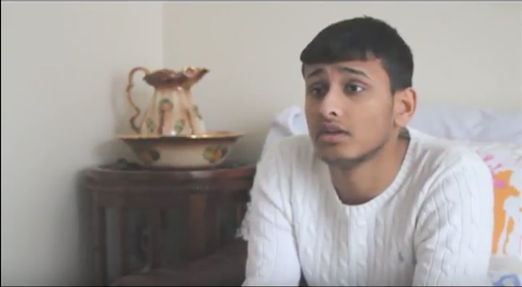
We did not only receive feedback through our target audience but we also asked our fellow media students at various stages of our production to tell us there thoughts about what they think about our music video. Unlike asking through questionnaires we get a more detailed response on what we should change and what we should include. Also as they are media students they are well aware of the financial restrictions that we have to endure during the media production so will give us a clearer response in terms of what we should include as it may not be unrealistic expectations like including a helicopter or a super car. Also as they are also doing a music video they will have better feedback in terms of shots and editing as they are experiencing the same process of editing and filming. An example of realistic feedback received from our fellow media students was the inclusion of a house. We learnt in our questionnaire that audiences expect to see a house in order to show love and security in a music video. As we wanted to show betrayal we asked our fellow media students whether a house was the most effective way of representing betrayal. They said showing the main character alone in a house would be the best way to show how lonely the main character may feel and the effects of betrayal upon someone. They said inclusion of close ups would also represent the loneliness that the main character may be feeling. We asked our fellow media students whether the scene where the main character is lip syncing in a mirror was effective in portraying grief and sadness where they replied it was very effective as the use of a mirror is a convention used in many media texts to convey sadness or anger.

Slide 8
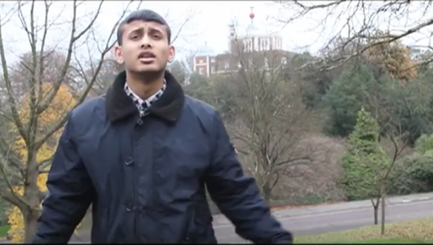
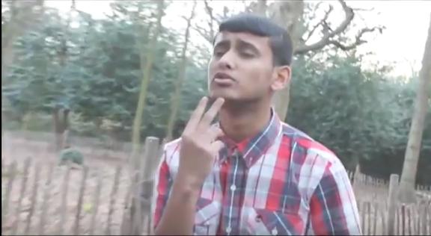
We also received constructive criticisms from our fellow peers in the costume chosen for our main character. They said they expected a main character in a R&B music video to have a distinctive look that sets them apart from the other main character. They said that the costume looked too similar to clothes that people would often wear everyday and that it does not follow the costume style used in many R&B music video in which the lead artist is shown to be wearing clothes that may be considered trendy and distinctive. By researching music videos in our genre we saw the costume choices by other artists and the criticism by fellow media students was harsh but true as we learnt that we needed to include clothes that are distinctive and don’t look like clothes you would wear often. We changed the costume for many of our scenes in order to follow the conventions of real media texts. An example of costume change was the change from a outside jacket which looked dull to a white cardigan which was bright and had the desired connotations of innocence. It also was distinctive in its look and sets it apart from the jacket. This could cause audiences to be attracted to the music video as the target audience is looking for an artist who is distinctive from the other artists and by changing the costume we have achieved this. Our fellow media students also asked us to include chains and watches in order to again set off a distinctive look. Also chains and watches are one of the conventions of a R&B music video as they are often worn by the artist in order to show that they are flashy and rich. This often provides escapism to the audience as they want all of these belongings and pretend they are the lead artists in order to get these belongings. This is something we wanted to do, as it is a good way to attract our target audience. We wanted to include close ups of the watches and chains in order the maximize the effectiveness. After making the amendments and changes we decided to ask our peers whether it has improved from our first draft of the music video in which they replied that it has improved drastically from the first draft and that the main character looks like he belongs in a music video unlike the first draft. From our feedback we learnt that costume is a huge factor in representation of a character in a music video as it can change what the audience think of him by the way he looks.

Slide 9
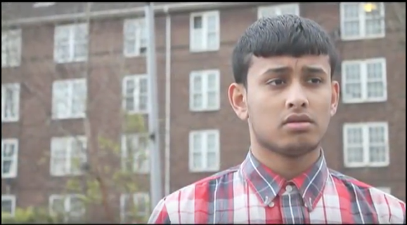
The 3rd type of feedback received were that of my teachers. Our teachers taught us to use a variety of camera shots in order to create different representation of what we were trying to show. In order to create the representation that the artist was full of grief and extremely upset over the revelation of his partners betrayal we used a long shot which eventually turned into a mid shot. Every step the artist took the more facial expressions that the audience could see. It started from mere curiosity to horrific shock by the end of the shot. The shot was continuous in order to show all the facial expression in one continuous moment in order to show the audience what betrayal may feel like. This was an example of using our feedback in our music video as we used a variety of camera shots in order to create different representations.

Slide 10
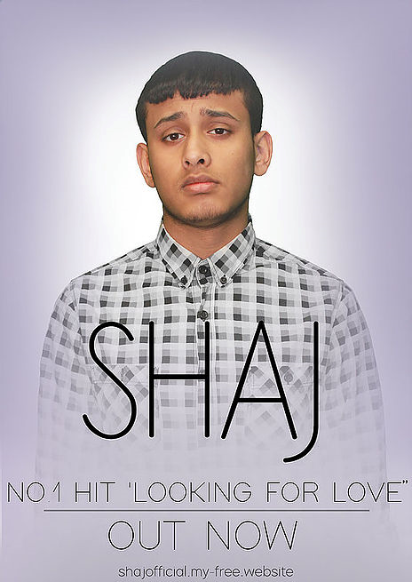
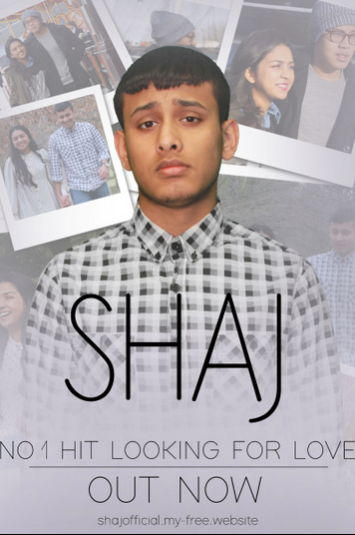
Audience feedback was not only used to construct our music video but we also received audience feedback in order to construct our magazine advert. When we made our first draft for our magazine advert we felt as though it was too dull but we needed outside counsel. We first asked our friends whether they thought it looked like a magazine advert in which they said that it was too dull to be a magazine advert, we then asked our media peers in which they also replied that it was too dull. After receiving this feedback we decided to put in something that will further link back to the music video. As a group we decided to put polaroid pictures of some scenes in the music video behind the lead artist. This creates anticipation for the music video as audiences will be eager to watch the music video after giving them a sneak peek of the music video. After creating the final draft we again showed this to our audience in which they said it was a massive improvement and that it finally looked like a magazine advert.

Slide 11
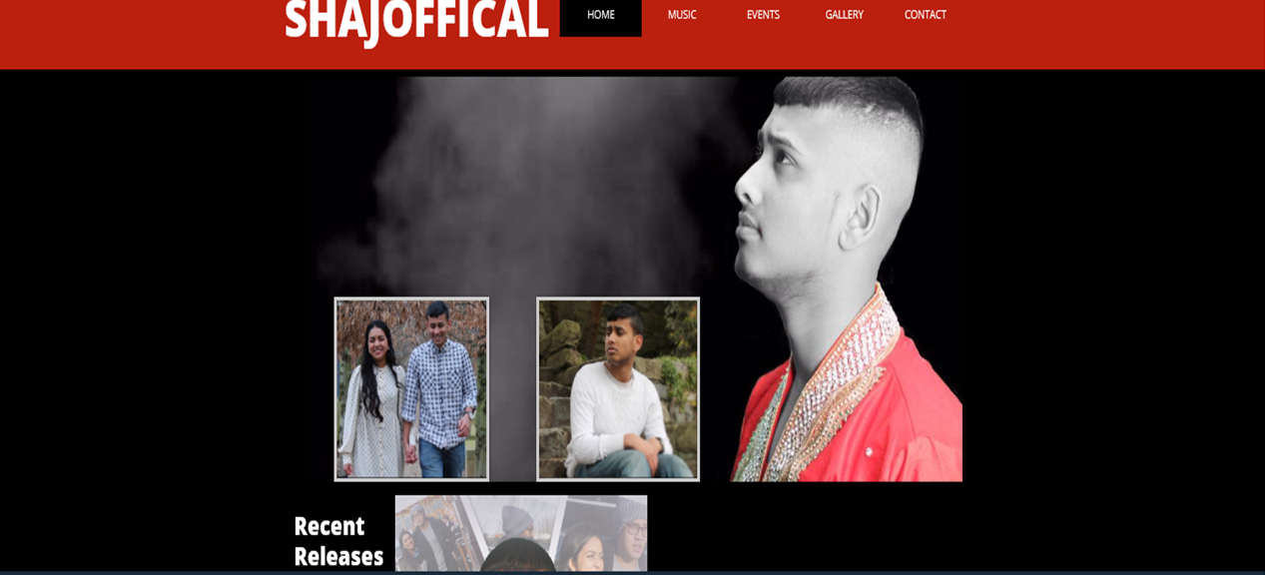
We also used audience feedback in the construction of our artists website.
We asked our audience and media peers what they expect to see in a artists website. They said that they expect to see a signifier or a link to the genre itself and not to a certain music video. Before receiving this information we decided to have our main image a image from the music video but after receiving this feedback we decided our main image should be the signifier of our genre. Something in which audiences can look at and immediately identify the genre. In this case after receiving this feedback we used a traditional attire associated with asians. This costume signifies the genre which is Hindi/R&B. This provides any new audience members that happen to come across our website to immediately see if they have come to the right place as the costume will signify the genre that our music video is in. We also received audience feedback that the colour scheme has to be consistent throughout the website. Our colour scheme was red and black and it was consistent throughout the website. We wanted our colour scheme to be red and black in order to match the main images colour of red and black. Also there are deep connotations associated with red and black like love and passion or darkness.

